Slide 1
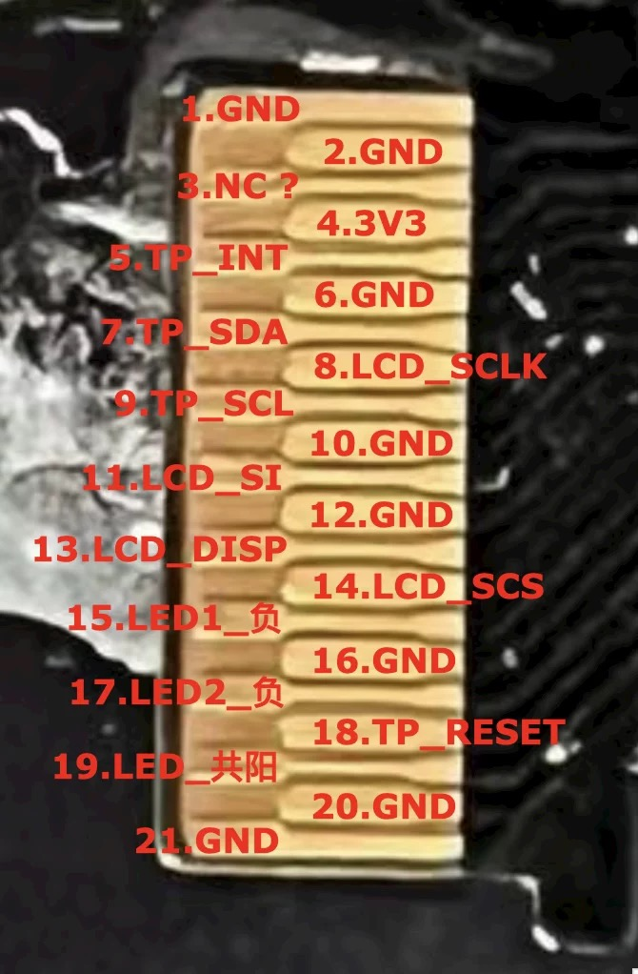
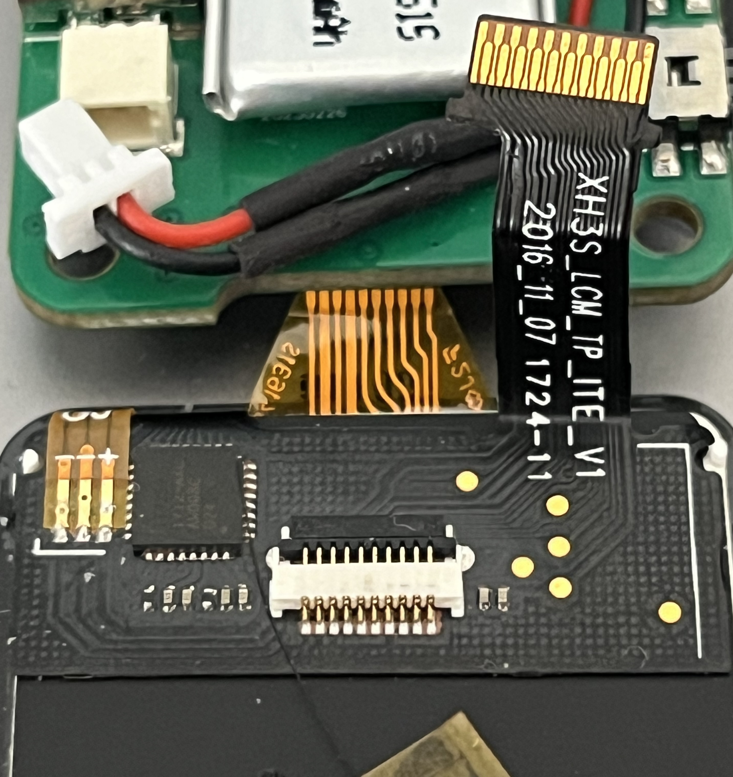
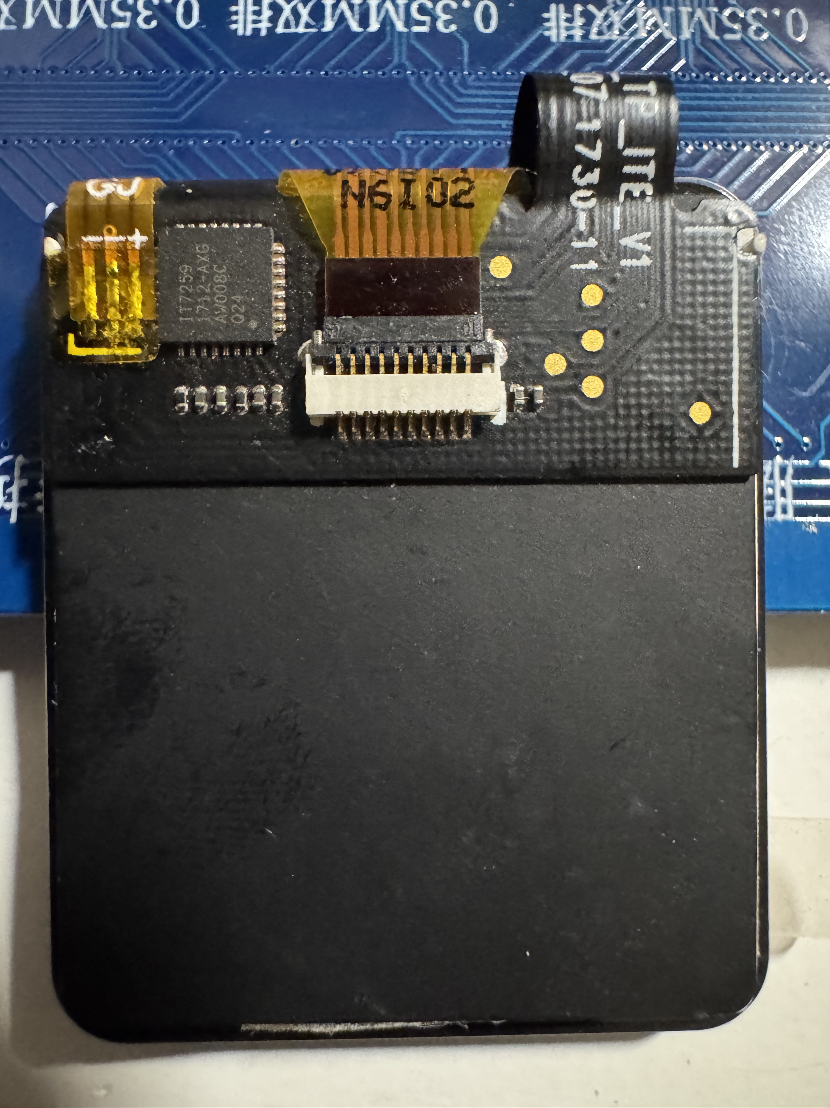
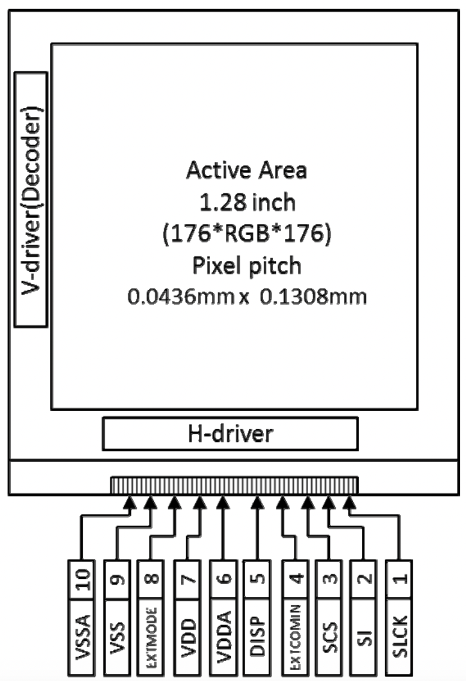
TP_RST
TP_SCL
15
17
19
TP_INT
TP_SDA
EXTCOMIN=GND
CS=Pin14
MOSI=11Pin
DISP
SCK=Pin8
VDD=3V3
VDD=3V3
VSS=GND
EXTMODE=GND
VSSA=GND
3V3
GND

